Slide 1
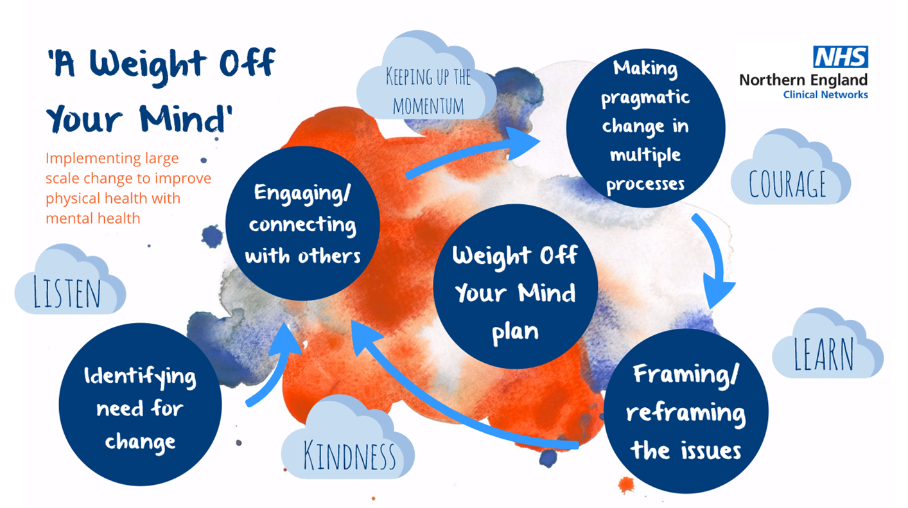

Slide 2











A Weight Off Your Mind – the partnership

Slide 3

Identifying need for change
Reviewing premature mortality data
Establishing health weight as a shared priority
Undertaking a literature review-understanding the evidence and gaps

Slide 4
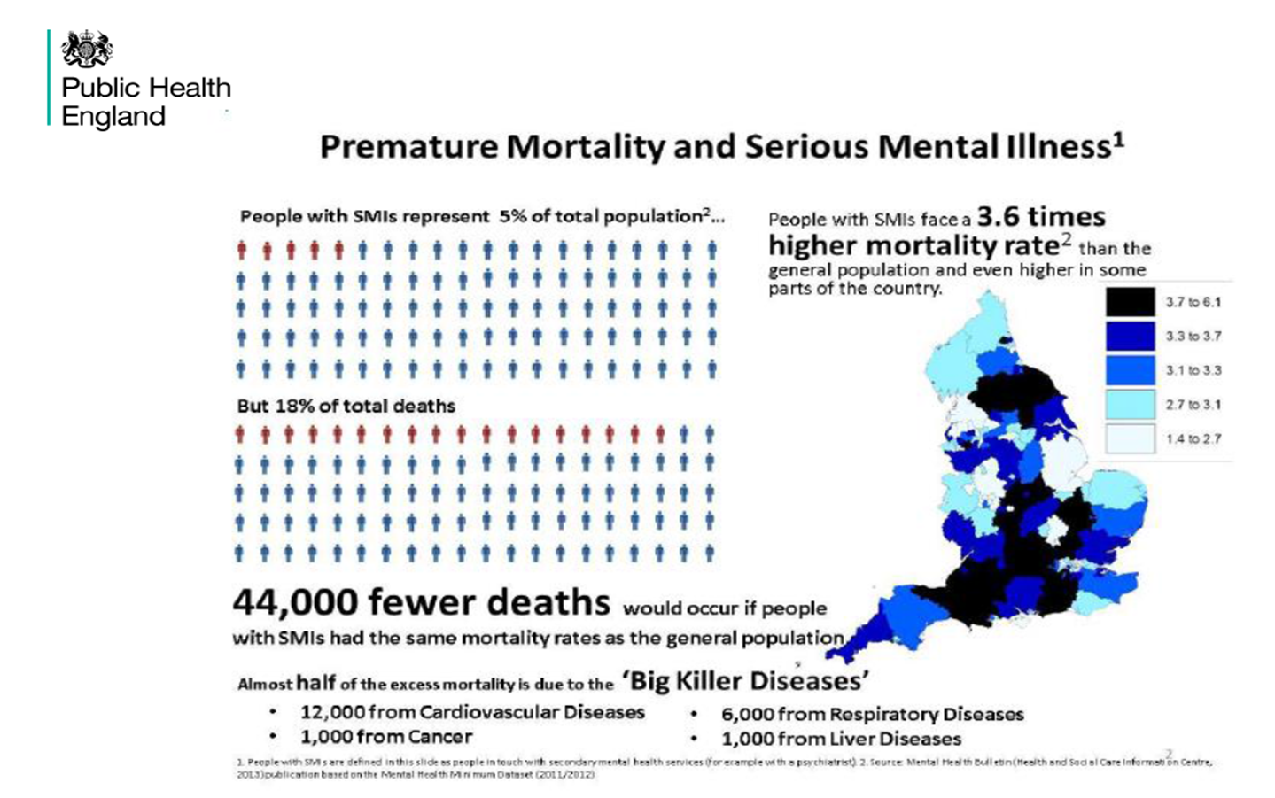
Premature mortality data

Slide 5
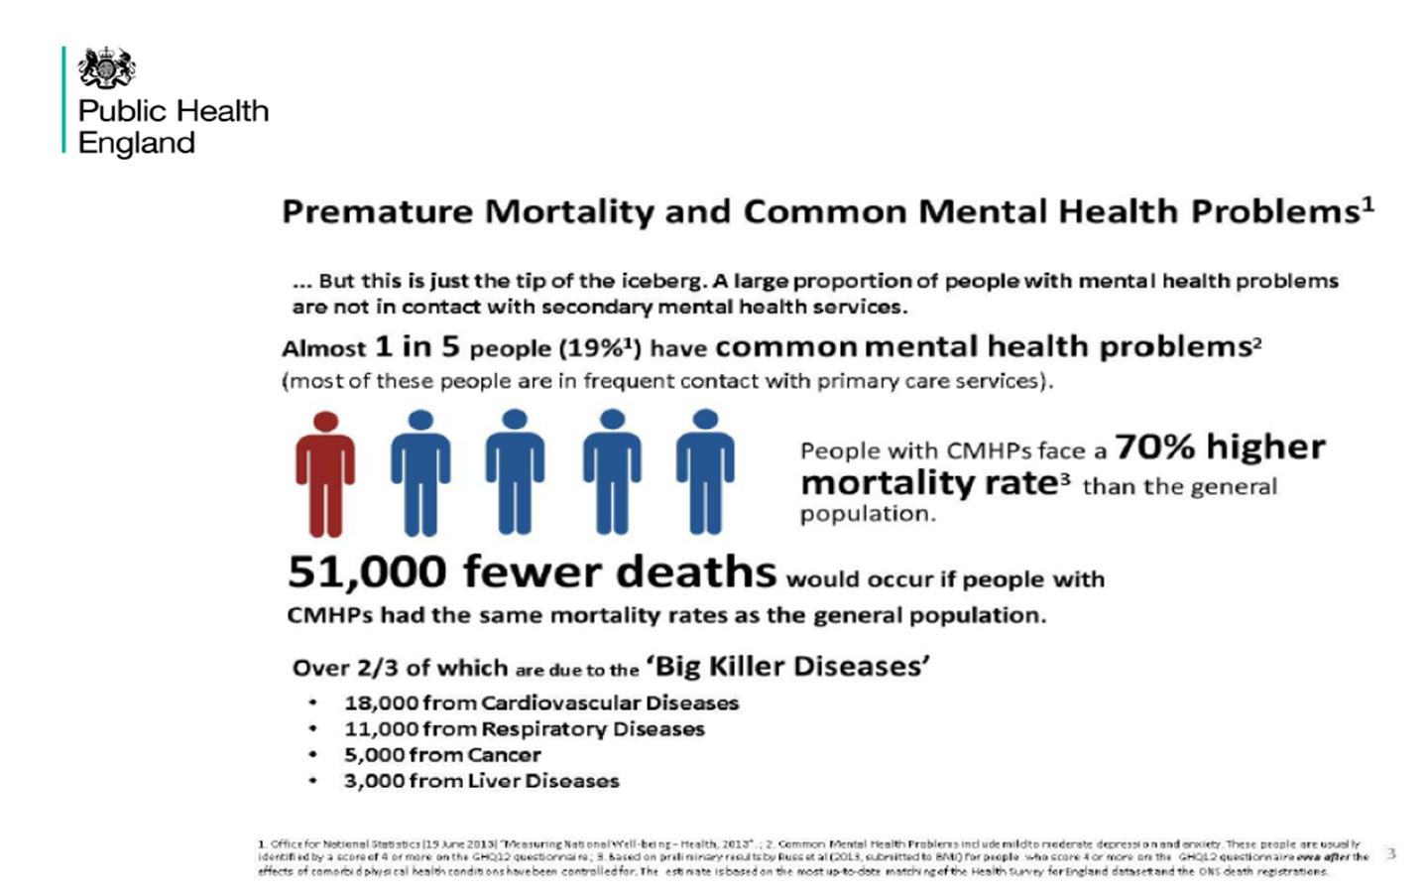
Premature mortality data

Slide 6

Engaging/connecting with others
Engaging and connecting with others through co-production
Co-production principles
What is good co-production?

Slide 7
The Weight Off Your Mind Plan
Leadership
Physical health screening
Food and nutrition
Improved access and opportunity for physical activity
Pharmacy/medicine management
Psychological therapies
Education and information
Developing community pathways
Children and young people
Learning disabilities

Slide 8

Making Pragmatic change in multiple processes and Framing and reframing the issues
Understanding the impact of language and tone
Making time for real co-production
Managing expectations through disruptions to the original timescales for development
Staying focussed on what’s important

Slide 9

Required behaviours and approaches

Slide 10
Some partnership pledges
“making every contact count”, not shying away from discussing the impact of weight and carry resources with me to offer people
listening to service user voices and implementing their views and thoughts into service provision wherever possible
offering informed choice, lifestyle coaching and listening to peoples aspirations offering guidance
encouraging those with lived experience to become involved in facilitating courses or updating procedures
listen and speak with specific groups to improve services – Then Act!

Slide 11
Some co production examples
Engagement from outset al at all levels of project from design of concept to implementation
Ownership of the ambitions
Development of “Proxys” to guide thinking on what matters and what good looks like form a service user perspective
Recognising contributions and access to a small budget

Slide 12

A Weight Off Your Mind resources

